Slide 1
UNIVERSITY INSTITUTE OF COMPUTING
PROJECT REPORT ON
Sales Report Analysis
Program Name: BCA
Subject Name/Code: DATA INTERPRETATION LAB /(22CAP-354)
Submitted by:
Submitted to:
Name: Gautam Gupta,Ketan Pathak UID:22BCA10857,22BCA0428
Section:22BCA-8A
Name: Simranjeet Singh Designation: Asst.prof

Slide 2
ABSTRACT
This project analyzes tactors sales data to uncover key insights that can boost business performance. By studying sales trends over time, location, and product categories, we identify peak sales hours, top-selling products, and revenue patterns. These insights help in making smarter decisions about pricing, inventory, and marketing. The goal is to improve customer satisfaction, streamline operations, and drive consistent business growth in a competitive market. Additionally, this study explores the impact of seasonal trends on sales and customer preferences, helping businesses prepare for demand fluctuations.
This study helps tractors shop owners identify top-performing and underperforming products. Data-driven strategies optimize menus, promotions, and staffing to match customer demand. Consumer behavior insights, like product pairings and peak spending, enhance upselling and bundling. These findings guide businesses in improving operations and boosting profitability in the tractors retail industry.

Slide 3
Introduction
The tractors industry is expanding rapidly, with increasing competition among businesses. To succeed in this dynamic environment, tractors shop owners must analyze customer preferences, sales trends, and product performance. Sales are influenced by multiple factors, including time of day, location, and seasonal variations. Understanding these patterns helps businesses make informed decisions about pricing, inventory management, and marketing strategies.
Leveraging data-driven insights allows tractors shops to optimize their offerings and improve customer engagement. Recognizing peak sales hours, best-selling products, and customer spending habits enables better workforce management and enhances service quality. Additionally, businesses can refine their menu, introduce promotional campaigns, and implement loyalty programs to attract and retain customers. By proactively adapting to market trends and consumer demands, tractors shop owners can maximize profitability and sustain long-term growth.

Slide 4
Technique
The data analysis process follows a structured approach.
1. Data Collection: Sales data is extracted from the provided dataset.
Data Cleaning: Handling missing values, duplicate records, and formatting inconsistencies.
Exploratory Data Analysis (EDA): Using descriptive statistics, visualizations (bar charts, heatmaps), and summary tables.
Statistical Analysis: Identifying trends using measures like mean, median, mode, and standard deviation.
Visualization: Graphical representation of sales trends using tools like Matplotlib,
Seaborn, and Power BI.
Insights and Recommendations: Based on trends, optimal sales strategies are suggested.
7. Predictive Modeling (Optional): Using machine learning techniques to forecast future sales trends based on historical data.
Customer Segmentation: Identifying different customer groups based on purchasing
behavior.
Competitor Analysis: Comparing sales trends with market competitors to identify areas of improvement.
10. Demand Forecasting: Utilizing historical sales data to predict future demand and optimize inventory.

Slide 5
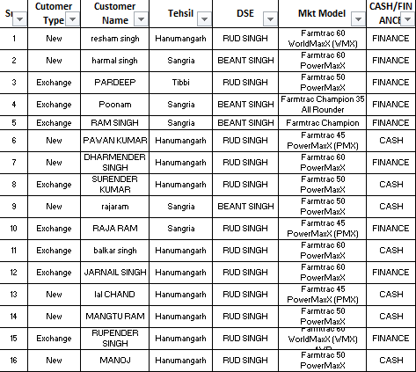
Tractors Sales Data:

Slide 6




Formula
Several statistical and business formulas were applied in the analysis:
Total Sales Revenue:
Average Order Value (AOV):
Peak Sales Hours Identification: Time-series analysis and frequency distribution.
Sales Distribution by Category: Percentage contribution of each category to total revenue.
Customer Retention Rate:
Profit Margin Calculation:
Market Basket Analysis: Identifying frequently purchased product combinations to optimize menu bundling.
Loyalty Program Effectiveness: Evaluating repeat customer purchases before and after introducing a loyalty program.

Slide 7
Result and Analysis
Sales Trend by Time: Peak sales occur in the morning (10 AM-3 PM)
Monthly Revenue: Sales show a gradual increase from March to June, peaking in April.
Store Performance: Location-based analysis reveals that downtown outlets generate higher sales.
Best-Selling Products: Farmtrac 60 PowerMaxX based items contribute the most to
total
Customer Spending Patterns: The average price per order is found to be 5 Lakhs,
with variations based on product categories.
Seasonal Impact: Seeding months exhibit increased sales due to demand for crop.
Marketing Influence: Promotions and loyalty programs have a direct impact on sales, increasing repeat customer visits.
Operational Efficiency: Data analysis helps in adjusting staff allocation to meet peak demand periods efficiently.
Impact of Discounts and Promotions: Sales increased by 15% during promotional campaigns, highlighting the importance of targeted discounts.
Online vs. In-Store Sales: Online orders accounted for 30% of total sales, emphasizing the need for digital engagement.

Slide 8
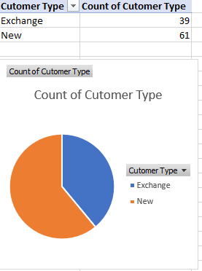
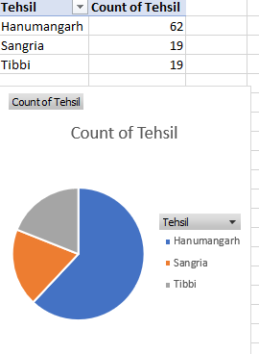
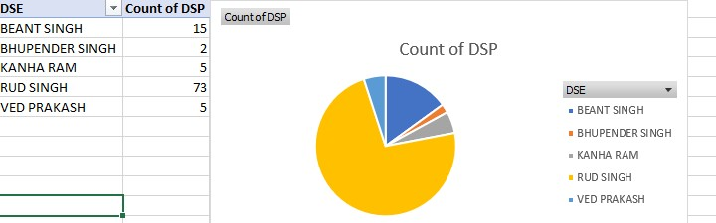
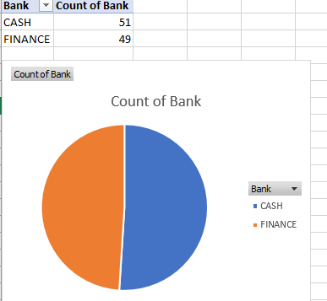
Dashboard:

Slide 9
SUMMARY
This analysis provides actionable insights to enhance tractors shop sales strategies. Recommendations include targeted marketing during peak hours, optimizing inventory based on demand patterns, and strategic pricing for best-selling products. Future work may include customer segmentation and predictive modeling to further refine business strategies.
Additionally, businesses should consider implementing dynamic pricing strategies, utilizing AI- driven demand forecasting, and expanding digital engagement through mobile applications. Personalizing customer interactions and continuously refining offerings based on feedback will further strengthen the competitive edge of tractors shops in an evolving marketplace.
. Further areas of study can include:
Influence of Customer Reviews: Understanding how online reviews impact sales and brand perception.
Sustainability Practices: Analyzing the effect of eco-friendly initiatives on customer loyalty.
Subscription Model Viability: Exploring the impact of tractors subscription services on long-term revenue.
Geospatial Analysis: Evaluating store location effectiveness and identifying potential expansion areas.
AI-Driven Insights: Using machine learning to predict customer preferences and automate marketing efforts.
Supply Chain Optimization: Enhancing procurement strategies to reduce costs and prevent stock shortages.

